Slide 1

E-Commerce Supply Chain:
Delivery Performance Audit
Root Cause Analysis of Late Deliveries & Operational Bottlenecks
David Sebastian Aritonang
Data Analyst | July 2026

Slide 2

Table of Contents
01 Business Context & Objectives
02 Tech Stack & Data Preparation
03 The Delivery Crisis: Macro Overview
04 Key Insights (Priority, Promotions & Cost)
05 Data-Driven Strategic Recommendations
06 Conclusion

Slide 3


Business Context & Objectives
The Pain Point
Key Objectives
The logistics division is experiencing a critical inflation in operational costs coupled with declining customer satisfaction. Initial reports suggest this is driven by an unacceptably high rate of late deliveries and a resulting surge in customer service inquiries.
Establish the true On-Time Delivery (OTD) failure rate across all shipments.
Identify correlations between logistics dimensions (shipment mode, priority) and delays.
Quantify the operational cost impact of late shipments on Customer Care resources.

Slide 4


Tech Stack & Data Preparation
Data Cleaning & Validation
Transformation & Visualization
Handled schema parsing errors by sanitizing headers via Google Sheets prior to database ingestion to ensure structural integrity.
Leveraged Google BigQuery (SQL) to engineer commercial metrics and categorical variables.
Validated missing values & duplicate IDs.
Aggregated late delivery rates using SQL logic.
Checked numerical outliers (weights, discounts).
Designed an interactive Executive Dashboard utilizing Tableau Public for stakeholder reporting.

Slide 5



The Delivery Crisis: Macro Overview
TOTAL SHIPMENTS AUDITED
LATE DELIVERY RATE
CUSTOMER CARE CALLS
10,999
59.67%
44,595
A staggering 59.67% of all shipments fail to meet their delivery Service Level Agreements (SLA). Consequently, this failure rate has forced nearly 11,000 customers to generate over 44,000 inbound calls to the support center, crippling operational cost efficiency.

Slide 6
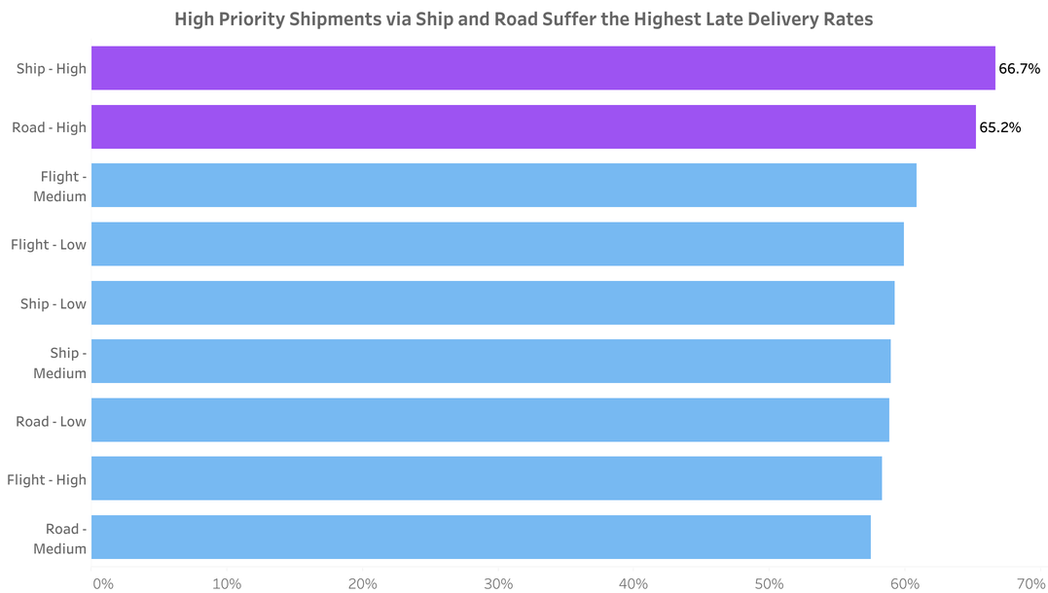

The Priority Paradox
Analyzing delivery rates by Mode of Shipment and Product Importance reveals a critical flaw in logistics routing.
Items marked as "High Priority" are ironically experiencing the highest failure rates.
Shipments routed via Ship - High Priority (66.7% Late) and Road - High Priority (65.2% Late) are the worst-performing segments in the entire network.
Business Implication: The fulfillment center's prioritization logic is broken. Paying for "High Priority" yields worse results than medium or low priority processing.

Slide 7
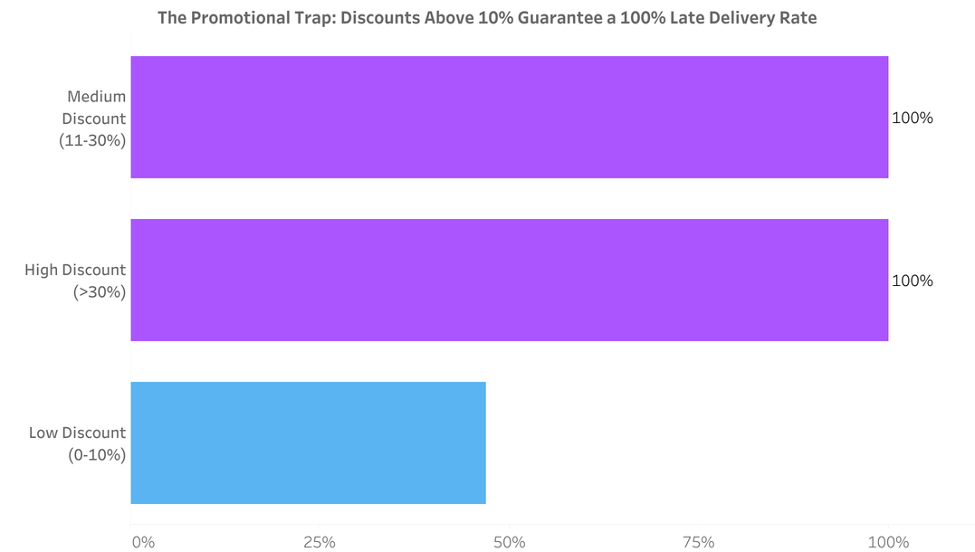

The Promotional Bottleneck
The most alarming anomaly in the dataset is tied directly to promotional discounting campaigns.
Orders with a Medium Discount (11-30%) and High Discount (>30%) suffer a catastrophic 100% Late Delivery Rate.
Conversely, orders with minimal discounts (0-10%) maintain a 50/50 chance of arriving on time.
Business Implication: Sales campaigns are choking the supply chain. Warehouse SLA algorithms fail to prioritize volume spikes, relegating heavily discounted items to the back of the queue.

Slide 8
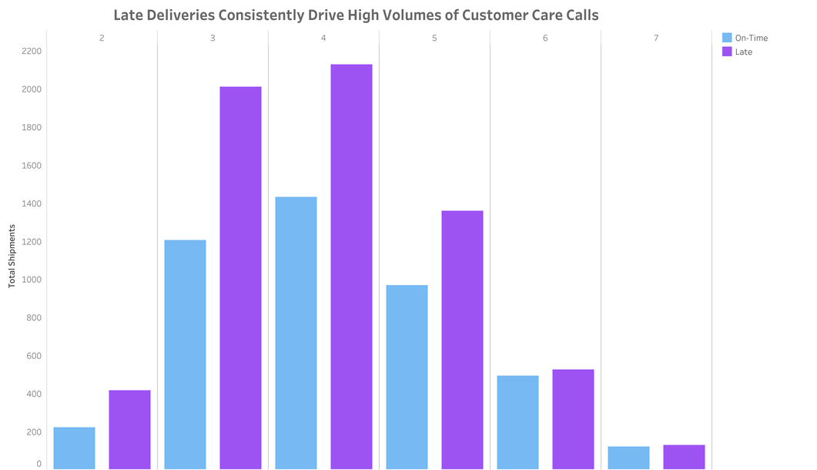

The Cost of Delays
Operational costs skyrocket due to customer friction caused by uncommunicated delays.
Customers experiencing late deliveries consistently drive the highest volume of inbound support inquiries.
The distribution peaks at 3 to 4 customer care calls per delayed order, absorbing massive human resources.
Business Implication: Without proactive tracking updates, the customer care center becomes a reactive bottleneck, exponentially increasing operational overhead per delayed package.

Slide 9






Data-Driven Strategic Recommendations
1. Overhaul Promotional Routing
2. Audit "High Priority" SLA
3. Proactive CS Deflection
Investigate warehouse algorithms immediately. Separate fulfillment pipelines must be established during marketing campaigns to prevent 100% SLA failure on discounted items.
Temporarily suspend "High Priority" offerings for Ship and Road freight until carriers can guarantee SLAs. Shifting critical items exclusively to Air freight may be necessary to salvage trust.
To reduce the massive cost of 44,000+ support calls, implement automated, proactive SMS/Email delay notifications. Customers call less when preemptively informed of delays.

Slide 10
Conclusion
The Core Bottleneck: "High Priority" shipments routed via Ship and Road are failing to meet Service Level Agreements (SLAs), suffering the highest late delivery rates at over 65%.
The "Discount" Trap: Order volume spikes from promotional discounts above 10% completely overwhelm fulfillment capacity, resulting in a catastrophic 100% late delivery rate for those items.
The Operational Cost: The domino effect of these delays creates a massive financial burden, driving over 44,000 inbound customer care calls as customers react to uncommunicated fulfillment issues.
The Strategic Fix: By fixing prioritization logic and implementing proactive communication, we can rapidly recover Customer Satisfaction while cutting operational support costs.

Slide 11
Explore the Full Project
DATASET
https://docs.google.com/spreadsheets/d/1I5bWdn3f6qGWsPNl63Y63PZEWlI40LFcdfmLyGDjiW8/edit?usp=sharing
TABLEAU PUBLIC
https://public.tableau.com/views/E-commerceSupplyChain/Dashboard?:language=en-US&:sid=&:redirect=auth&:display_count=n&:origin=viz_share_link
GITHUB
https://github.com/davidsebastianart/ecommerce-delivery-performance-audit

Slide 12
THANK YOU

